Slide 1


IoT-Based Smart Traffic & Toll Management System
Using ESP32 and Blynk
Course: Embedded IoT Systems – Fall 2025
Group: Tech X
Team Members: Saim Mustafa, Ibtisam Butt, Shahzaman Dhillon

Slide 2

INTRODUCTION
Revolutionizing Urban Mobility
Smart traffic systems and automated toll management are rapidly transforming urban environments.
These innovative solutions leverage cutting-edge technology to create more efficient and sustainable transportation networks.
The integration of IoT is paramount for optimizing traffic flow, reducing congestion, and streamlining toll collection processes, ultimately enhancing the daily lives of commuters.

Slide 3
THE CHALLENGE
Addressing Inefficiencies in Traditional Systems
Congestion from Fixed Signals
Manual Toll Gate Delays
Need for Automation
Manual toll gates are bottlenecks, increasing waiting times, fuel consumption, and requiring significant human resources for operation and management.
There is an urgent need for an automated, IoT-based traffic and toll system that can adapt in real-time, reducing human intervention and improving overall efficiency.
Traditional traffic signals operate on fixed timings, leading to unnecessary delays and severe congestion, especially during peak hours or in dynamically changing conditions.

Slide 4






PROJECT GOALS
Key Objectives for Smarter Infrastructure
Real-time Vehicle Density Detection
Blynk Cloud Monitoring & Control
Accurately detect and count vehicles in each
lane to inform dynamic decision-making.
Integrate with Blynk for remote monitoring and control
of the entire system.
Dynamic Traffic Signal Control
Auto & Manual Operation Modes
Implement adaptive signal timing based on
live traffic data to optimize flow and
minimize waiting.
Provide both autonomous operation and manual
override capabilities for flexibility.
Automated Toll Gate Operation
Reduce Waiting Time & Congestion
Enable seamless, automatic opening and
closing of toll gates upon vehicle detection.
Significantly decrease vehicle waiting times and
alleviate traffic congestion in urban areas.

Slide 5





SYSTEM OVERVIEW
A Connected Approach to Traffic Management
Traffic Lane Sensors
Infrared (IR) sensors continuously monitor vehicle presence and density on each lane.
Toll Sensor & Actuators
A dedicated IR sensor detects vehicles at the toll plaza, triggering an automated servo motor for gate control.
ESP32 Controller
The central processing unit, the ESP32, gathers data, executes logic, and manages all connected components.
Cloud Connection & App
Data is sent to the Blynk cloud via Wi-Fi, allowing for real-time monitoring and control via a mobile application.

Slide 6
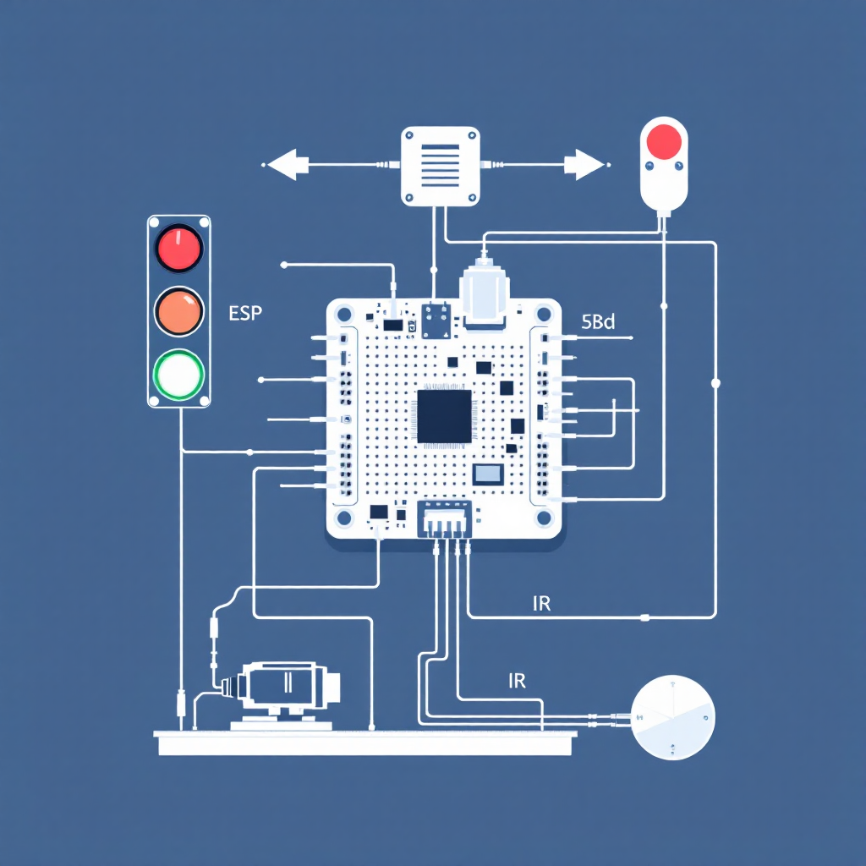

ARCHITECTURE
Integrated System Block Diagram
WiFi Connectivity
ESP32 Microcontroller
ESP32 to cloud link
Central controller
Servo Motor
ESP32 System
Architecture
Traffic IR Sensors
Toll gate actuator
Lane vehicle detection (3)
Traffic LEDs
Toll IR Sensor
Red/Yellow/Green signals
Vehicle at toll detection

Slide 7

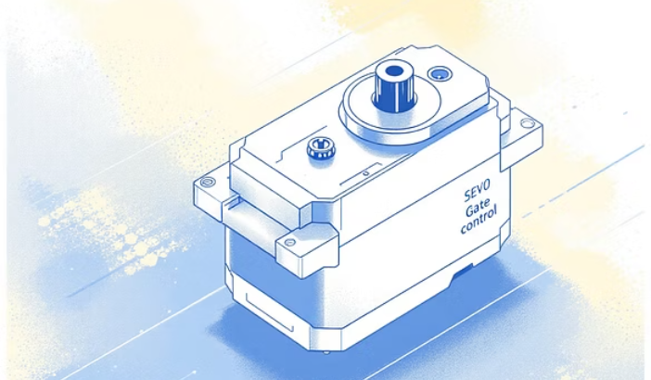

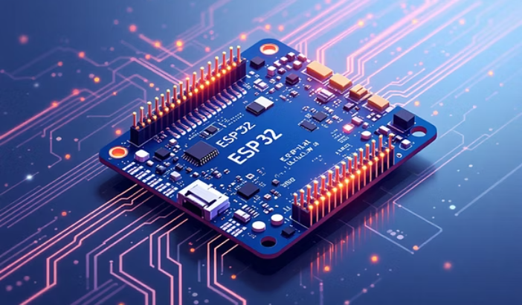





HARDWARE
Building Blocks of the System
ESP32 Microcontroller
IR Sensors
The brain of the system, handling data processing and component control.
Used for accurate vehicle detection at traffic lanes and toll gates.
Servo Motor
Power Supply & Wiring
Actuates the toll gate, ensuring smooth and automated opening/closing.
Provides stable power and connects all components on a PCB or breadboard.
LEDs & Resistors
Visual indicators for traffic signals and
system status.

Slide 8

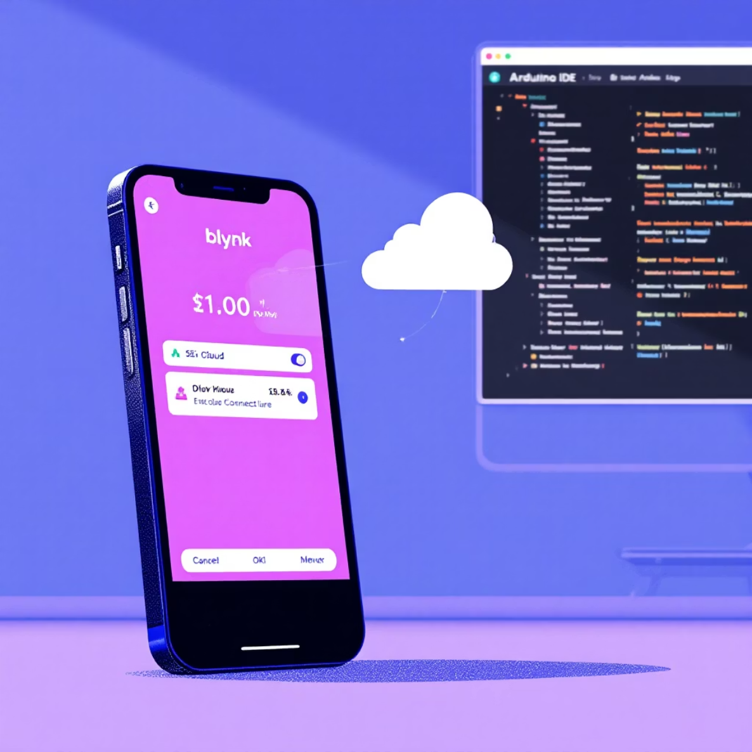



SOFTWARE & IOT
The Digital Core and Cloud Interface
Arduino IDE & Libraries
The primary development environment for programming the ESP32, utilizing essential ESP32, WiFi, and Blynk libraries.
Blynk Mobile Application
Provides an intuitive user interface for remote monitoring, control, and interaction with the system.
Cloud-based Real-time Monitoring
Enables continuous data exchange and live status updates, accessible from anywhere via the Blynk cloud platform.

Slide 9

TRAFFIC MANAGEMENT
Intelligent Lane Control Logic
01
02
Vehicle Detection via IR Sensors
Real-time Vehicle Counting
Each lane is equipped with IR sensors to accurately detect the presence of vehicles as they approach.
The system counts the number of vehicles in each lane to determine traffic density and demand.
03
04
Preemption Check for Priority
Dynamic Signal Sequencing
A critical check is performed to identify if a lane has a predetermined number of vehicles (e.g., ≥2), signaling higher priority.
Based on vehicle density and preemption rules, the traffic signals cycle through Green → Yellow → Red, optimizing flow for congested lanes.

Slide 10
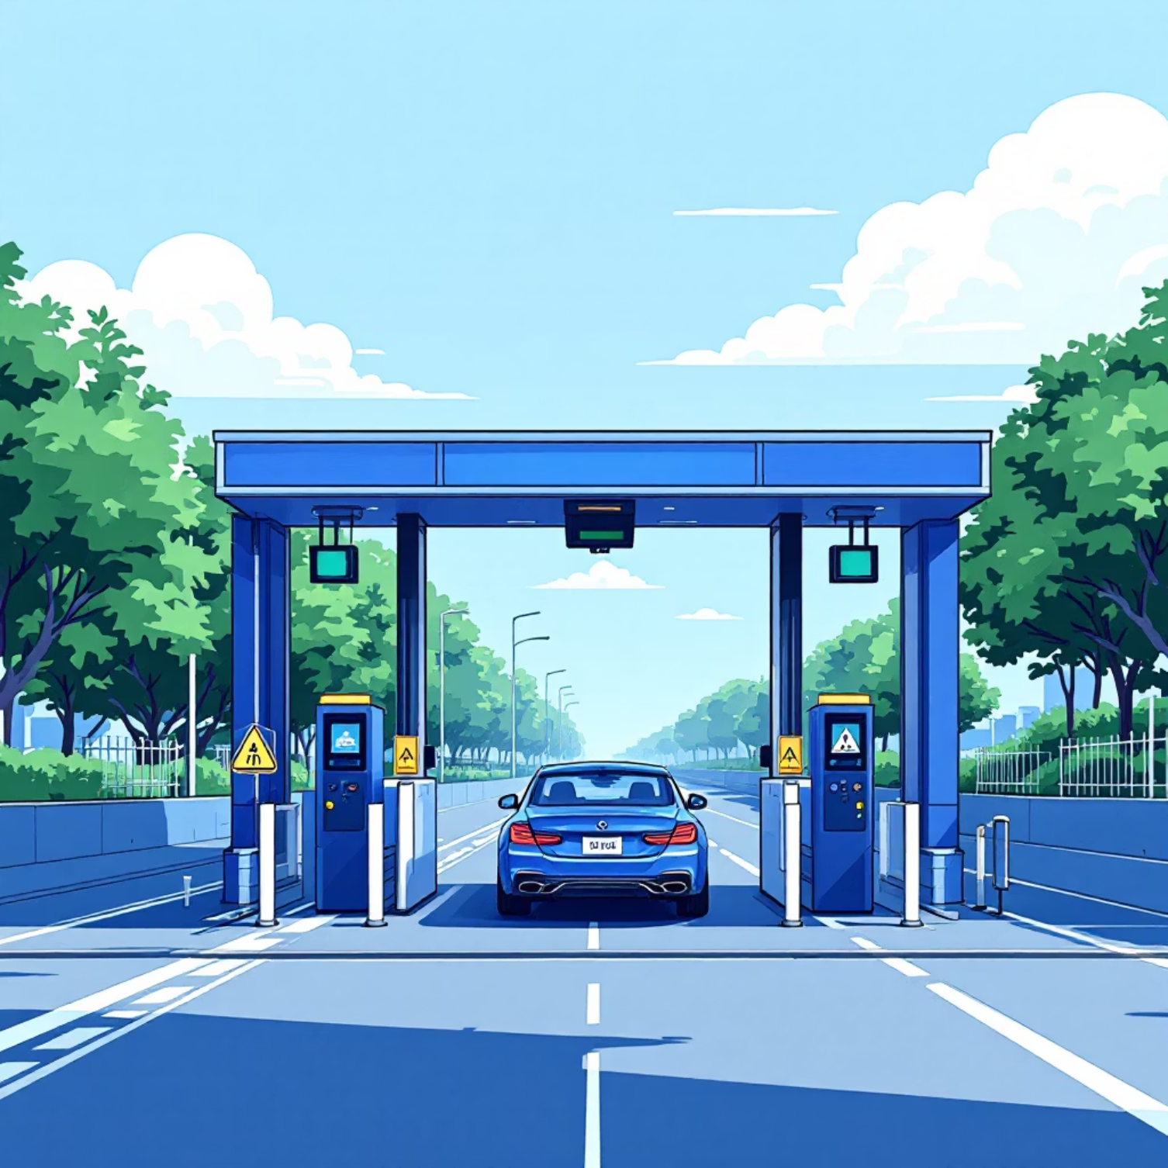
TOLL PLAZA AUTOMATION
Effortless and Controlled Access
Toll IR Sensor Activation
An IR sensor precisely detects a vehicle entering the toll plaza area.
Automatic Gate Opening
Upon detection, the servo motor automatically opens the toll gate for a preset duration, typically 5 seconds, allowing passage.
Blynk App Manual Control
For exceptions or emergencies, the toll gate can be manually controlled through the Blynk mobile application, providing operational flexibility.

Slide 11
System Workflow: A Step-by-Step Flowchart
Start System Initialization
The system powers on and initializes all connected sensors and actuators, establishing communication with the Blynk platform.
Read IR Sensors (Traffic & Toll)
Infrared sensors continuously monitor vehicle presence at traffic intersections and toll booths, capturing real-time data.
Count Vehicles Per Lane
The ESP32 microcontroller processes IR sensor data to accurately count vehicles in each traffic lane.
Check Preemption (≥2 Vehicles)
The system assesses traffic density; if a lane has two or more vehicles, it triggers a preemption sequence for priority.
Change Signals: Green → Yellow → Red
Traffic lights dynamically adjust based on preemption logic, optimizing traffic flow by changing states sequentially.
Toll IR Detect → Open/Close Servo
At the toll gate, IR sensors detect vehicles, prompting the servo motor to open for passage and then close.
Send Data to Blynk App
All operational data, including vehicle counts and signal statuses, is transmitted to the Blynk mobile application for monitoring.

Slide 12
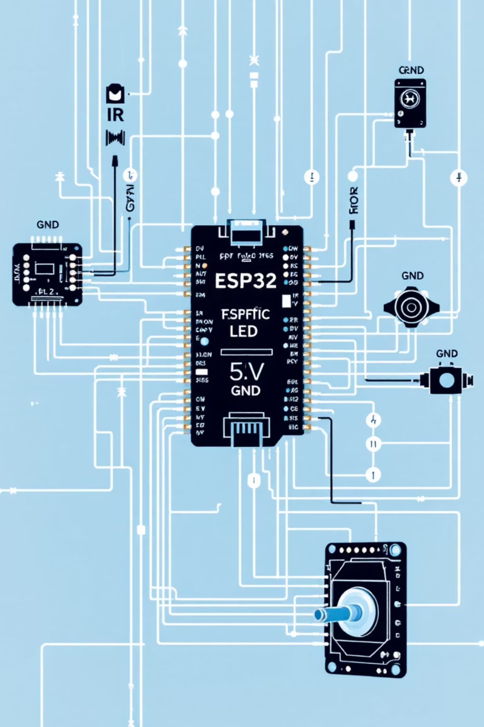
Hardware Integration: ESP32 Circuit Diagram
The core of our system relies on the ESP32's versatile General Purpose Input/Output (GPIO) pins to interface with various components.
Key Connections
Power & Ground
Traffic LEDs: Connected to specific GPIO pins for signal control (Red, Yellow, Green).
5V Supply: Common power rail for all components requiring 5 volts, ensuring stable operation.
IR Sensors: Dedicated pins for precise vehicle detection at both traffic and toll points.
Ground (GND): Shared ground connection for all components to complete the electrical circuit.
Servo Motor: Linked to a PWM-capable GPIO pin for accurate gate opening and closing.
Integrated Design: A compact and efficient layout minimizing wiring complexity.

Slide 13



System Performance: Results & Observations
Our IoT-Based Smart Traffic & Toll Management System delivered robust and reliable performance, validating the design principles.
Dynamic Traffic Signal
Operation
Automated Toll Gate Control
Auto/Manual Mode
Functionality
Real-time Vehicle Counts
on Blynk
Traffic signals adjusted fluidly based on real-time vehicle counts detected by IR sensors, significantly improving intersection efficiency.
The toll gate servo motor responded precisely to vehicle detection, ensuring seamless and automated opening and closing for passage.
Both automatic (sensor-driven) and manual (Blynk app controlled) modes functioned correctly, offering operational flexibility.
Vehicle counts were accurately displayed and updated in real-time on the Blynk dashboard, providing instant monitoring capabilities.

Slide 14

Blynk Dashboard: Real-time Monitoring and Control
The Blynk mobile application serves as the central hub for monitoring and interacting with our smart traffic and toll system.
Vehicle Counts (V4–V6)
1
Displays the current number of vehicles detected in each traffic lane, offering a live overview of traffic density.
Auto/Manual Mode Selector (V7)
2
Allows users to switch between automated sensor-driven control and manual override for traffic signals.
Preemption Status Indicator (V8)
3
Shows whether a traffic preemption sequence is active, indicating priority given to a high-density lane.
4
Current Active Lane (V9)
Identifies which lane currently has the green signal, providing clear operational status at a glance.

Slide 15





Conclusion & Future Scope
The "IoT-Based Smart Traffic & Toll Management System" successfully demonstrated an innovative approach to urban mobility challenges.
Achievements
Future Scope
Intelligent Traffic Management
Camera-Based Detection
Successfully implemented dynamic traffic signal control based on real-time vehicle detection, reducing congestion.
Incorporate computer vision for advanced vehicle classification and precise counting.
Cloud Analytics & Prediction
Automated Toll Operations
Leverage cloud computing for data analysis, traffic pattern prediction, and optimization.
Developed an efficient automated toll gate system, enhancing throughput and minimizing manual intervention.
Multi-Intersection Integration
Expand the system to manage multiple interconnected intersections for city-wide traffic synchronization.
Real-time Monitoring
Integrated with Blynk for intuitive real-time monitoring and control, providing operators with actionable insights.
Emergency Vehicle Priority
Implement a dedicated module for recognizing and prioritizing emergency vehicles, ensuring faster response times.

